Slide 1

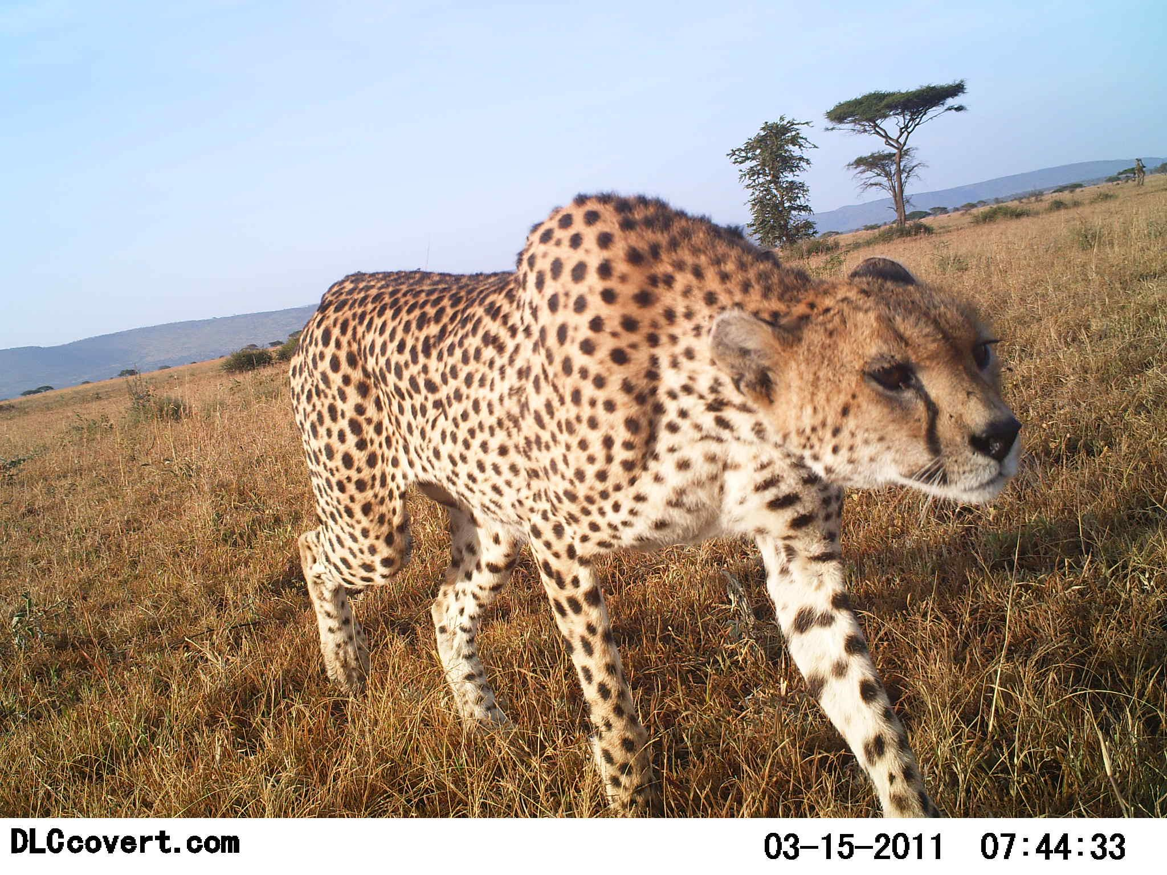
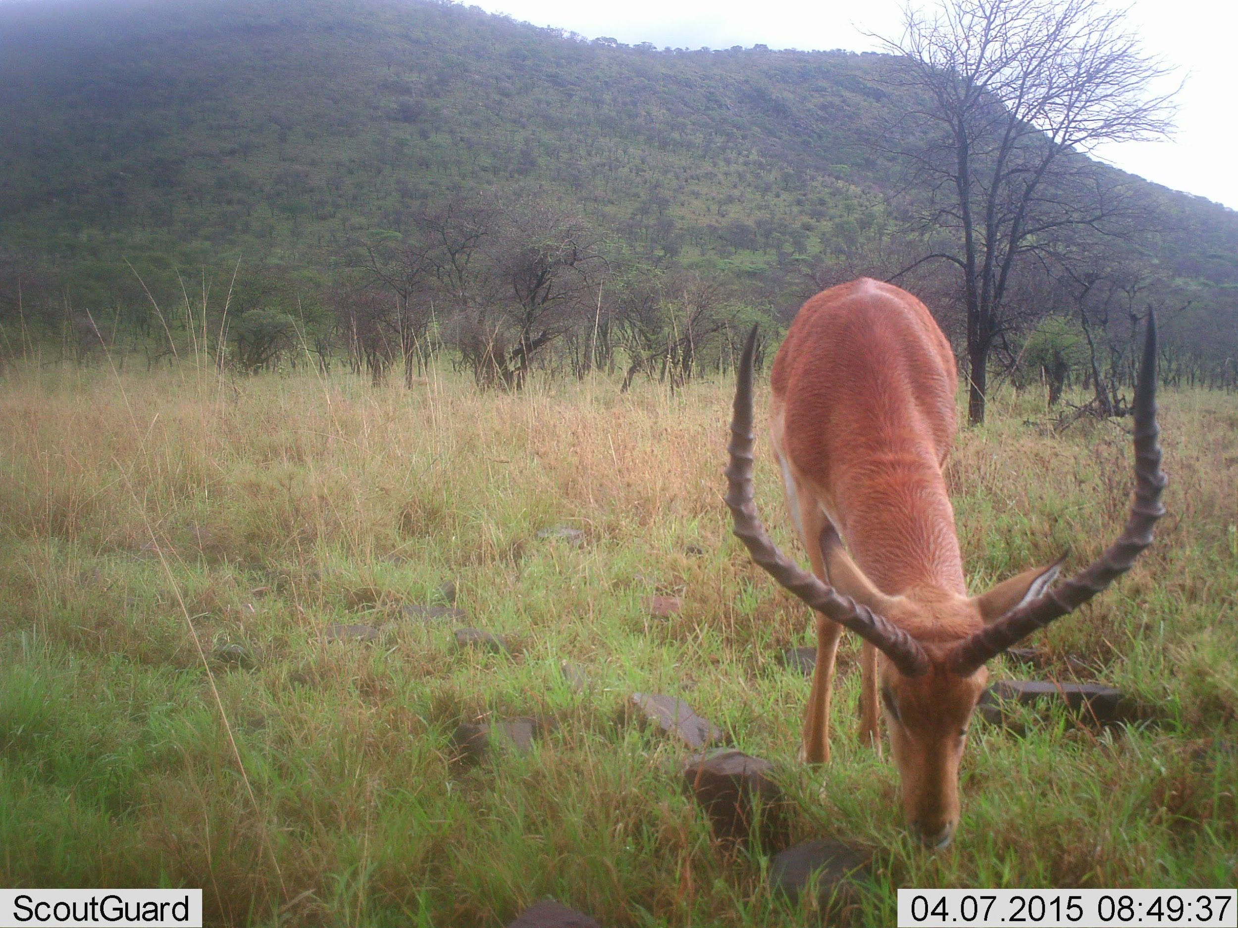
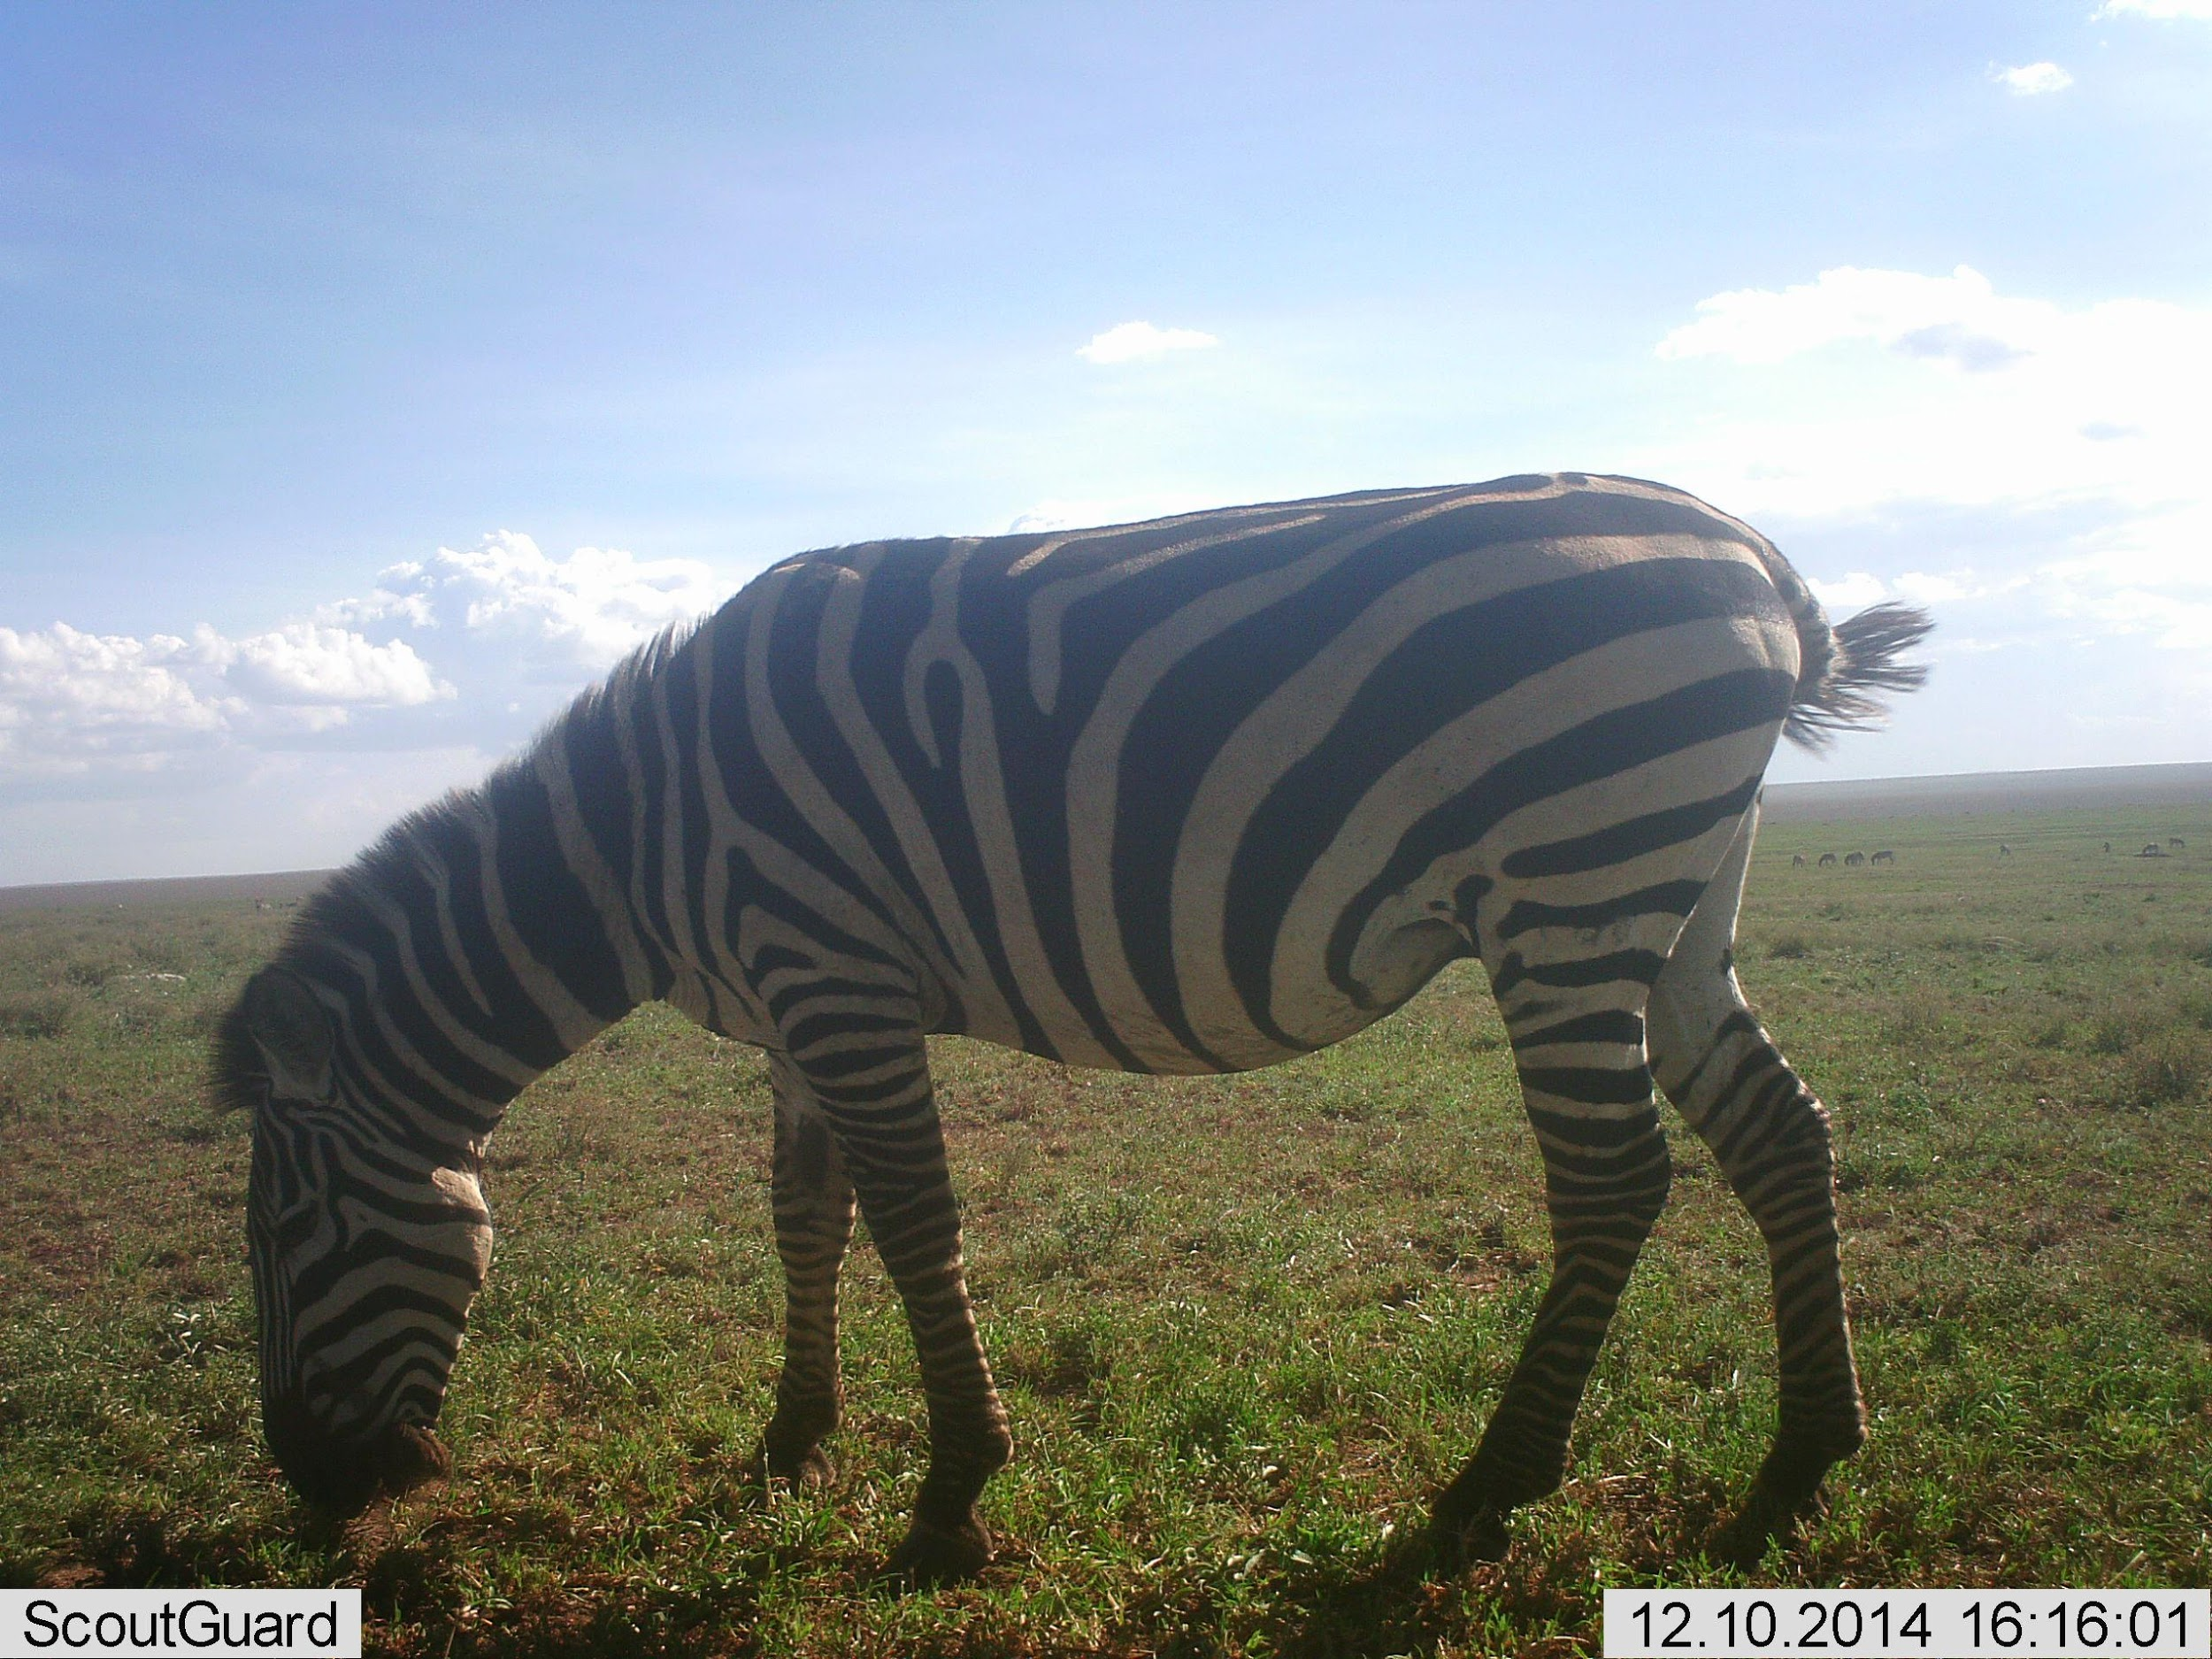
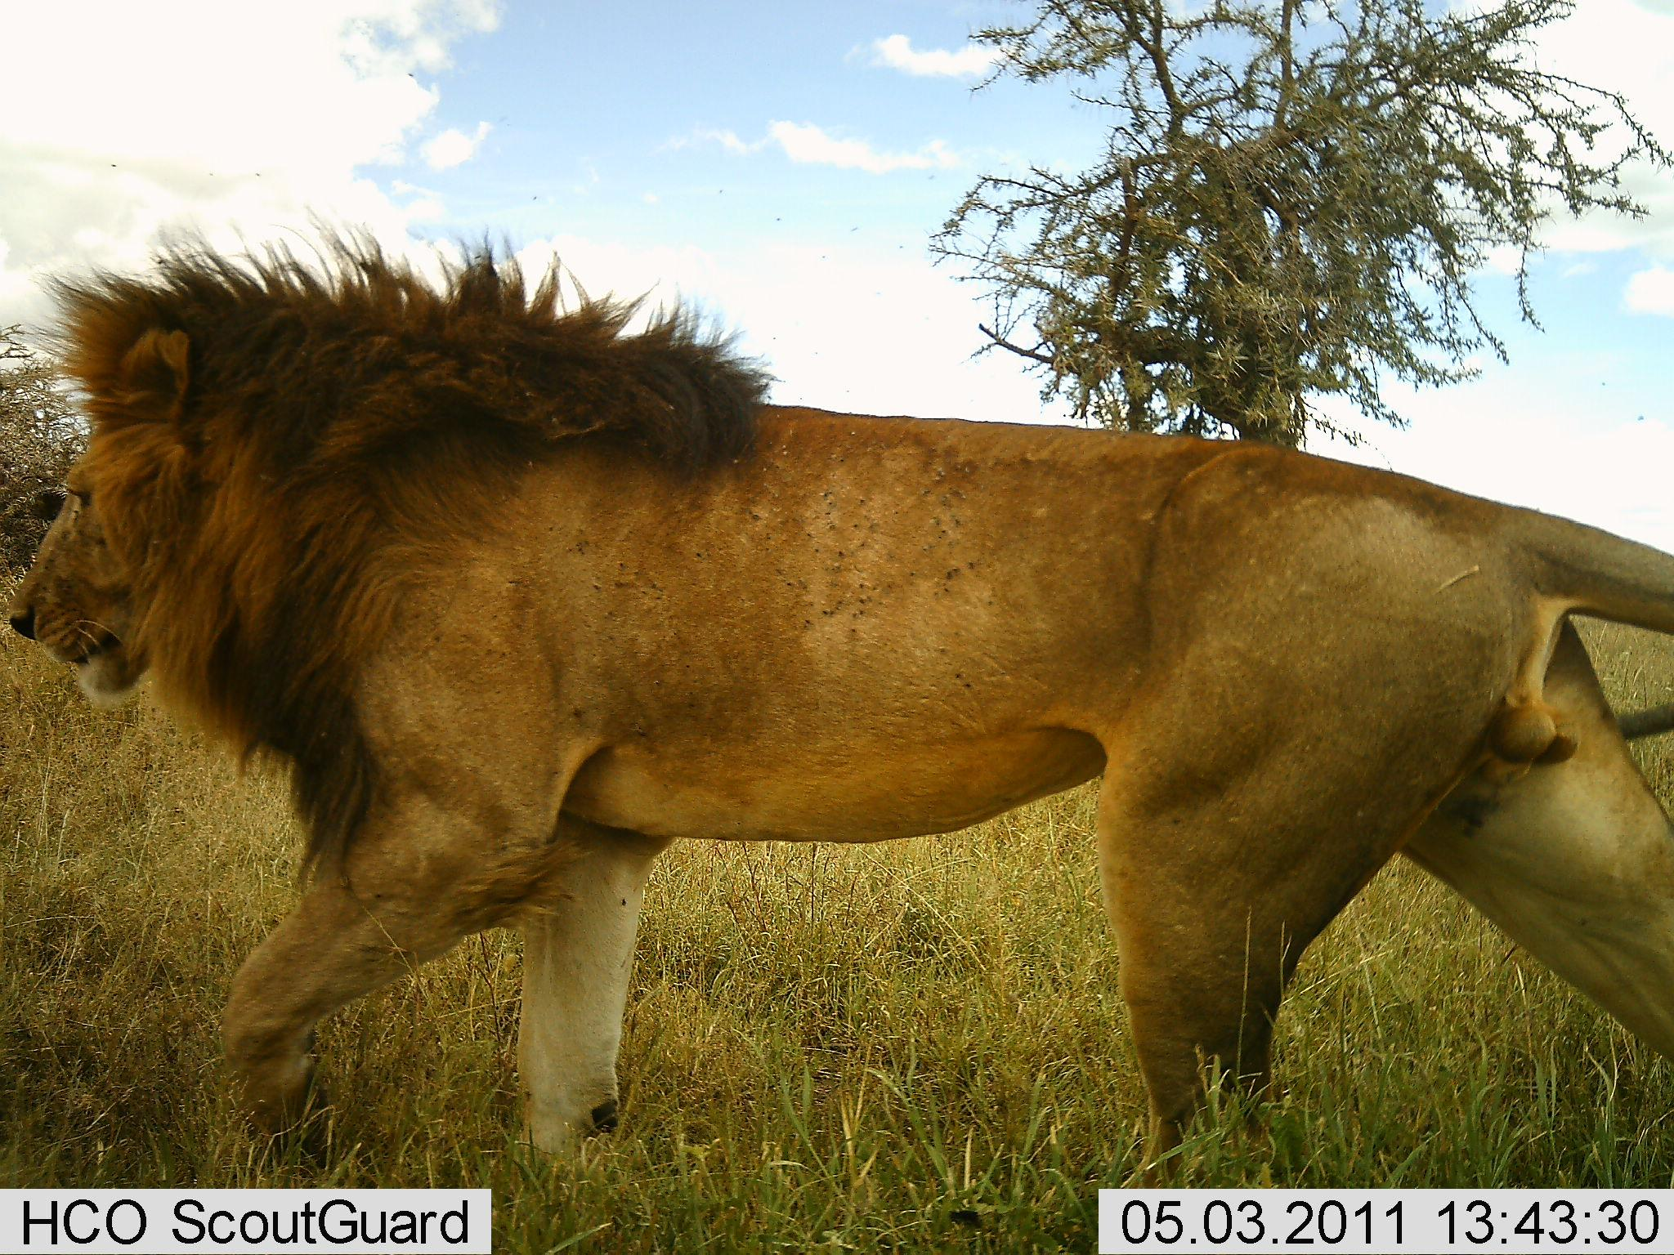
Snapshot Serengeti Image Classification

Slide 2
Project Motivation
Create a Convolutional neural network (CCN) capable of identifying animals caught in photos captured from camera traps
Inspired by Microsoft Snow Leopard project
Compare a scratch CNN to ones developed using transfer learning
Have fun and learn something new.

Slide 3
Technology Used
Development done in Google Colab Pro
Run time used GPU and High Ram Instance
Files stored in Google Drive (Mounted to Colab Pro)
Reasons
Ease of use and standard working environment
Working installation of Keras, no version issues
Access to GPU and RAM
Only $10, no surprise billing

Slide 4

Where Does the data Come from?
Data collected as part of Snapshot Serengeti
Part of The Serengeti Lion Project
330 lions in 24 prides
Trap Cameras (225 total)
Triggered by passive infrared
Scoutguard 565 and DLC Covert Reveal (Shown in the footer of each image)
Scientific Questions
Carnivore Existence
Herbivore Existence
Predatory Prey Relationships
https://www.zooniverse.org/projects/zooniverse/snapshot-serengeti/about/research

Slide 5
Data Source
There were 11 seasons of the program
2,688,077 images
Approximately 596 GB per season, 5,709 Total
Mostly blank
Some sequence (not always)
Species | Count | Percent
blank | 1998455 | 74.30%
wildebeest | 197080 | 7.30%
zebra | 139214 | 5.20%
elephant | 21658 | 0.80%
human | 17106 | 0.60%
impala | 16849 | 0.60%
lionFemale | 5828 | 0.20%
cheetah | 2630 | 0.10%
lionMale | 1748 | 0.10%

Slide 6
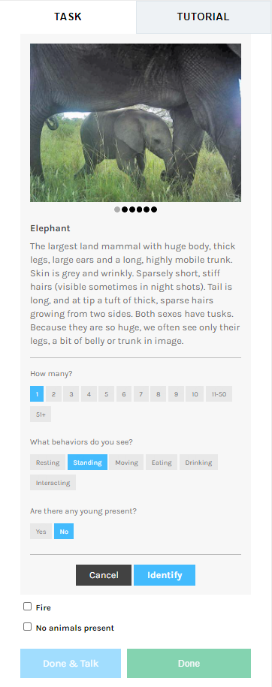
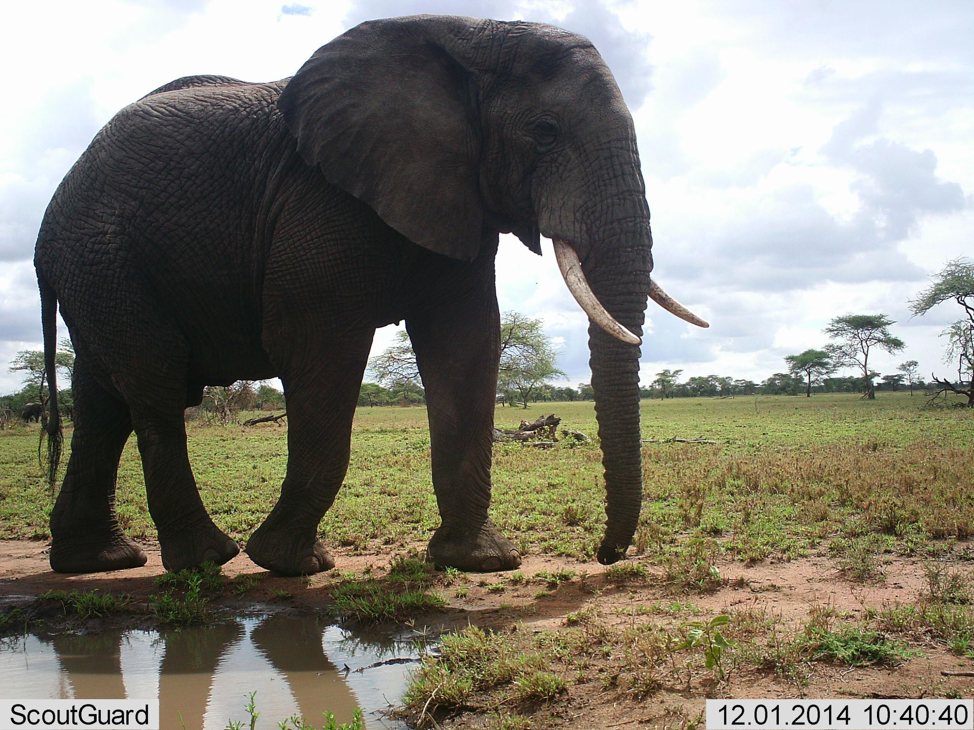
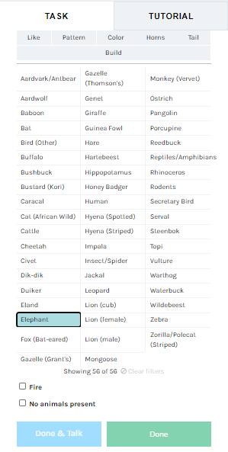
Image Identification
Image classification crowdsourced through Zooniverse
https://www.zooniverse.org/projects/zooniverse/snapshot-serengeti
Participants asked to identify a trap photograph
63 species including blank, human, and fire.

Slide 7
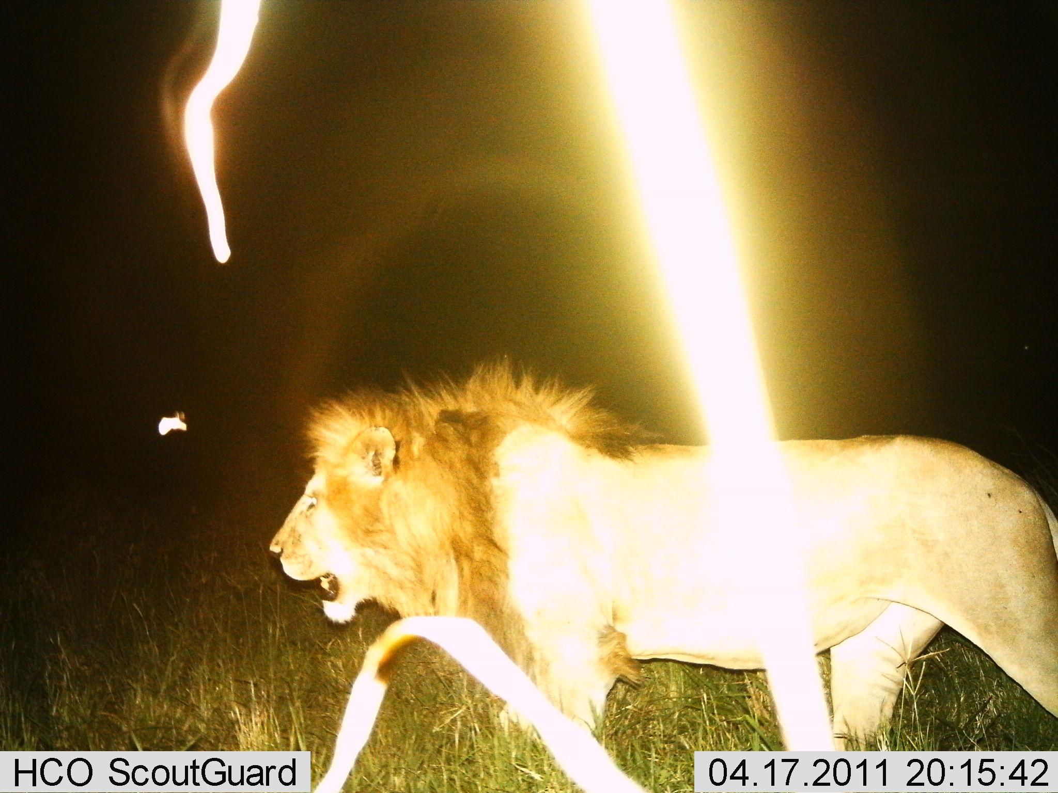
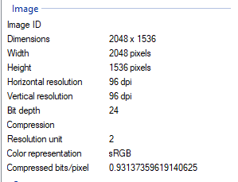
Image Properties

Slide 8
Data Download
LILA BC: Labeled Information Library of Alexandria: Biology and Conservation (http://lila.science/datasets/snapshot-serengeti).
Modified Program Built for accessing data without zip files
https://github.com/microsoft/CameraTraps/blob/master/data_management/download_lila_subset.py
Downloaded one species at a time
Each season for Elephant, Impala, Zebra
All seasons at once for Cheetah, and male/female lions
Uses metadata file to know what to download

Slide 9
Manual Selection of Images for Raw Data
Selected images suitable for analysis
Most seasons had 200 images selected
Cats had 1000 images selected total
Verified correct species
Ensured enough of animal showing and good position
Simplification of real-world data
Cat images commonly featured incomplete images of cats or only certain features

Slide 10
Image Distribution
80/10/10 Train/Test/Validation
All 5718/717/713
Cheetah = 800/100/100
Elephant ≈ 1360/171/169
Impala ≈ 1388/174/173
Lion = 800/100/100
Zebra ≈1372/172/171

Slide 11
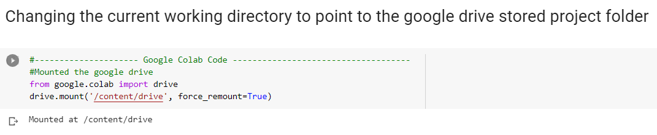
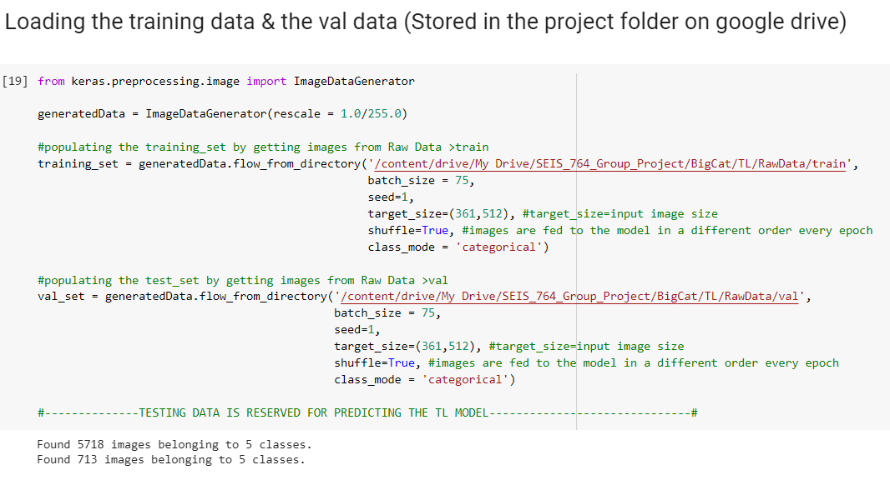
Data Generation

Slide 12
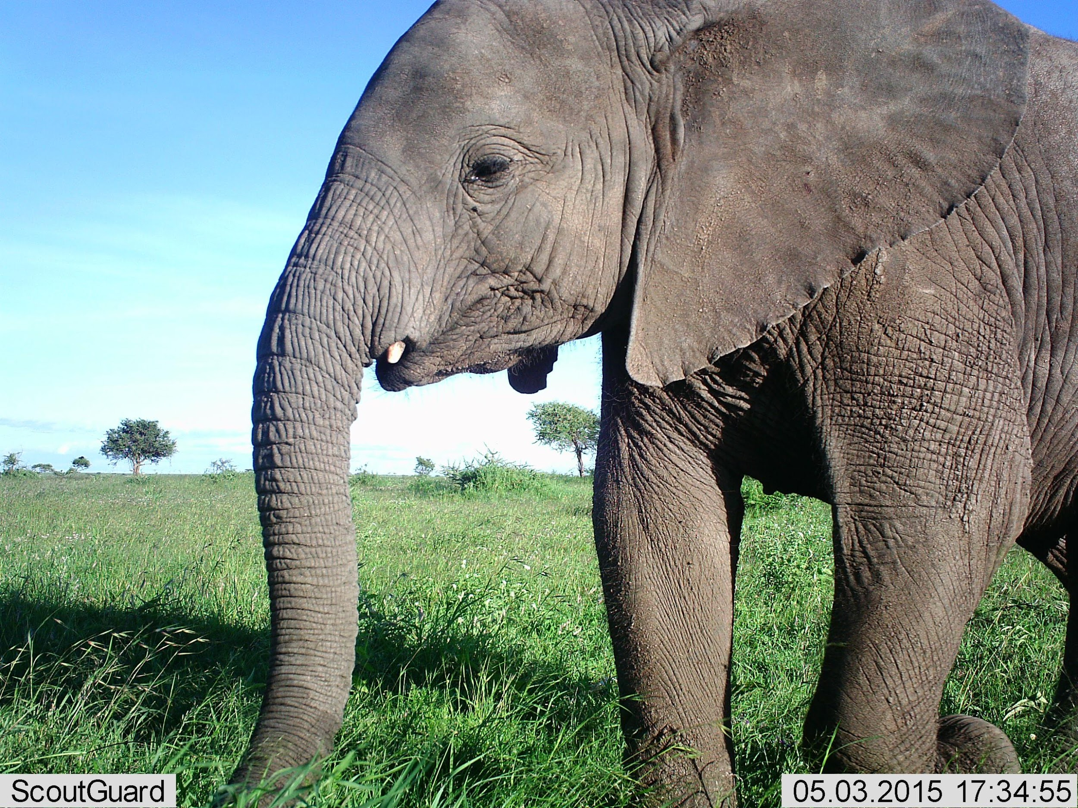
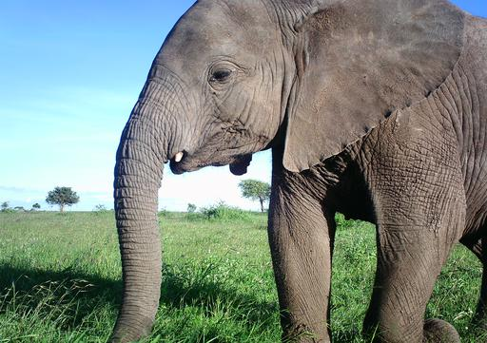
Image Processing
Removed footer
Prevented training on timestamp or camera type
Resized/compressed 361 X 512 (scaled down)
Allowed to have larger batch size and less memory and disk overhead
Memory exhaustion even on small batch sizes

Slide 13
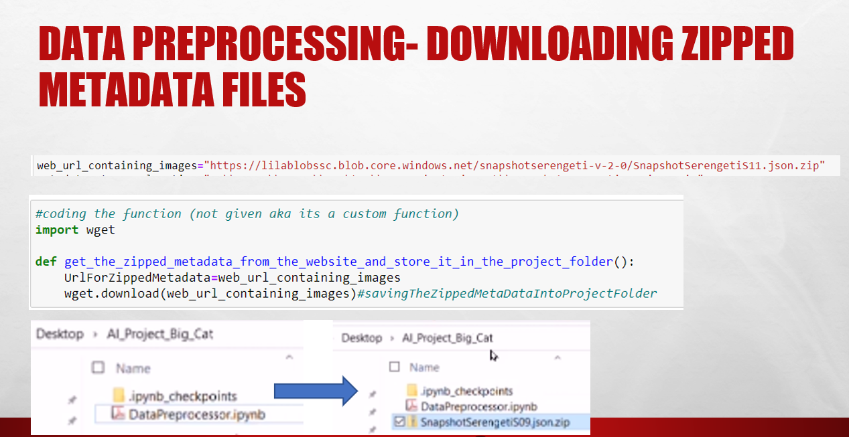

Slide 14
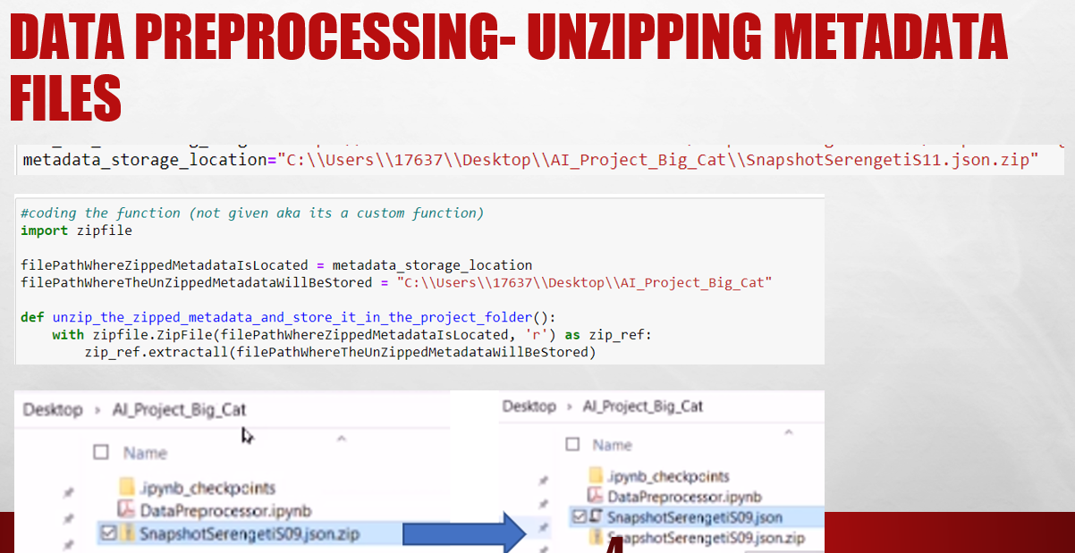

Slide 15
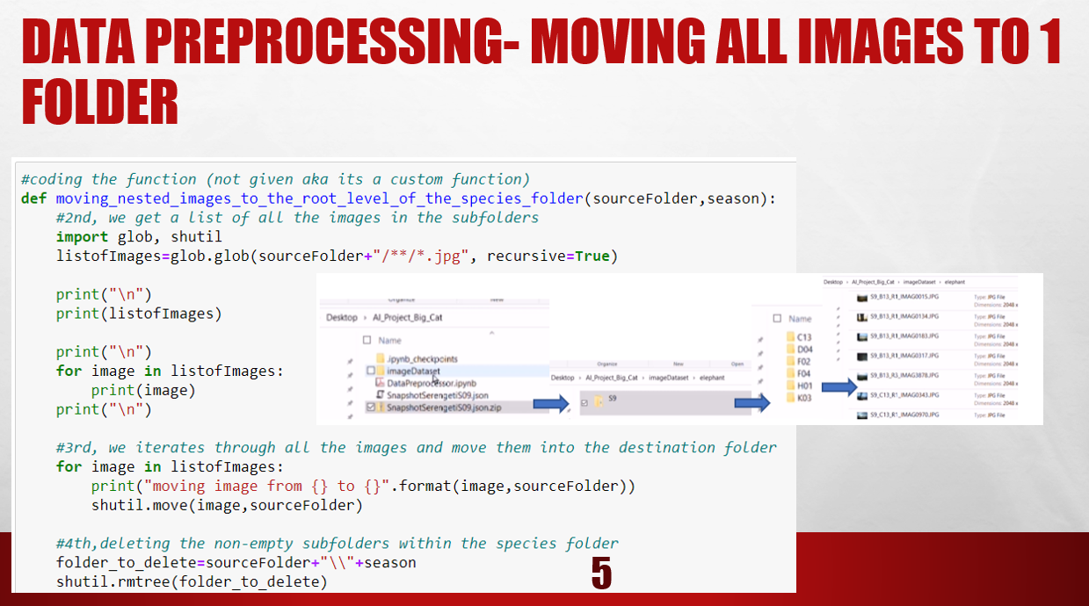

Slide 16
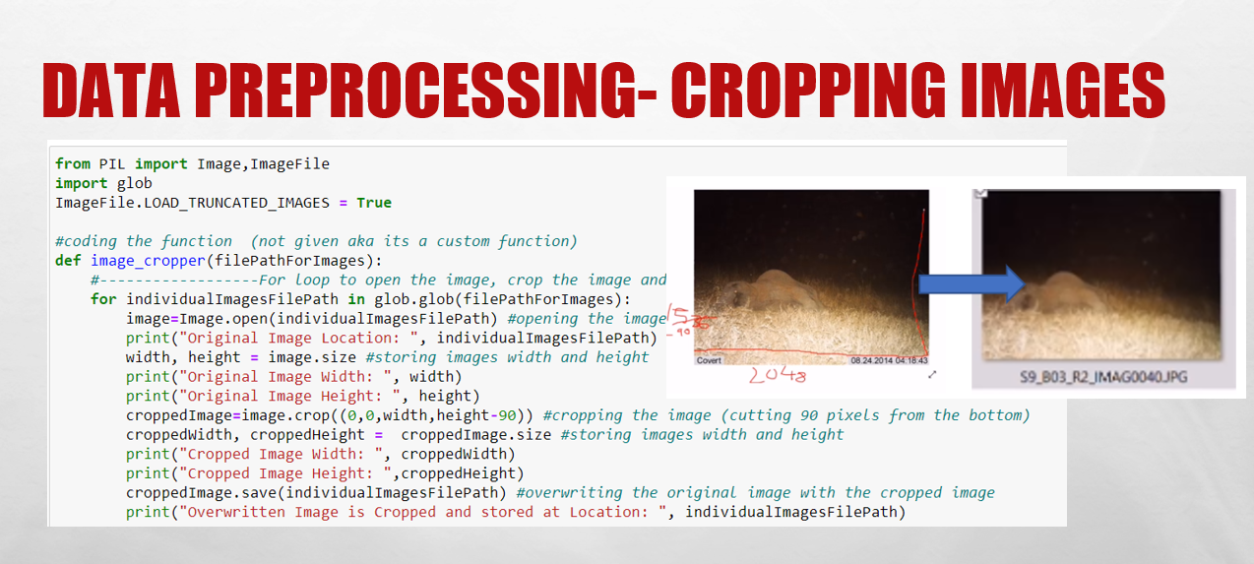

Slide 17
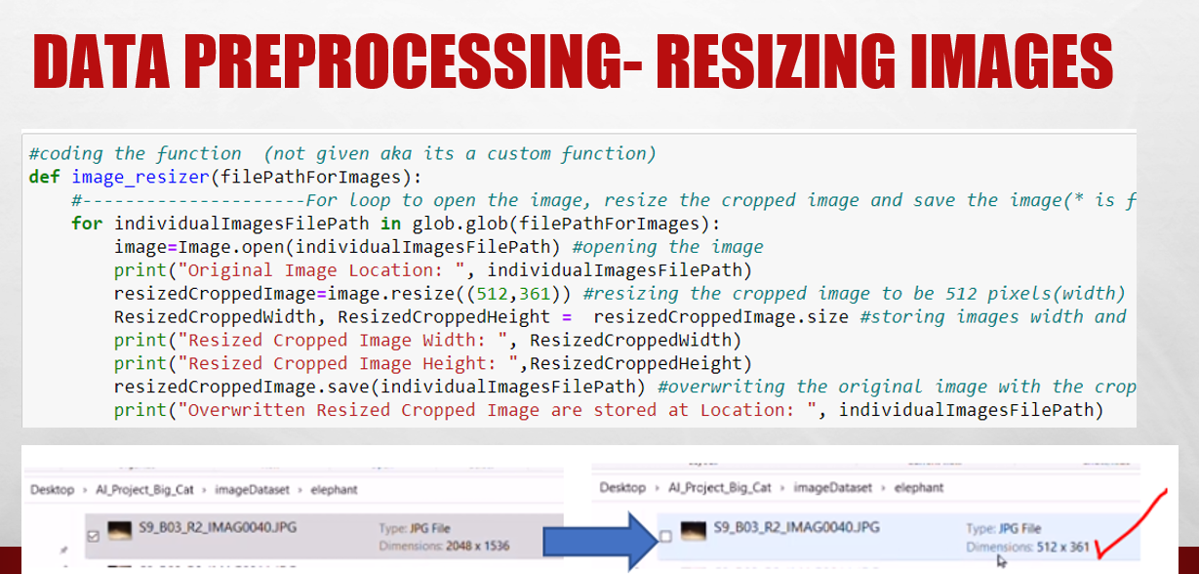

Slide 18
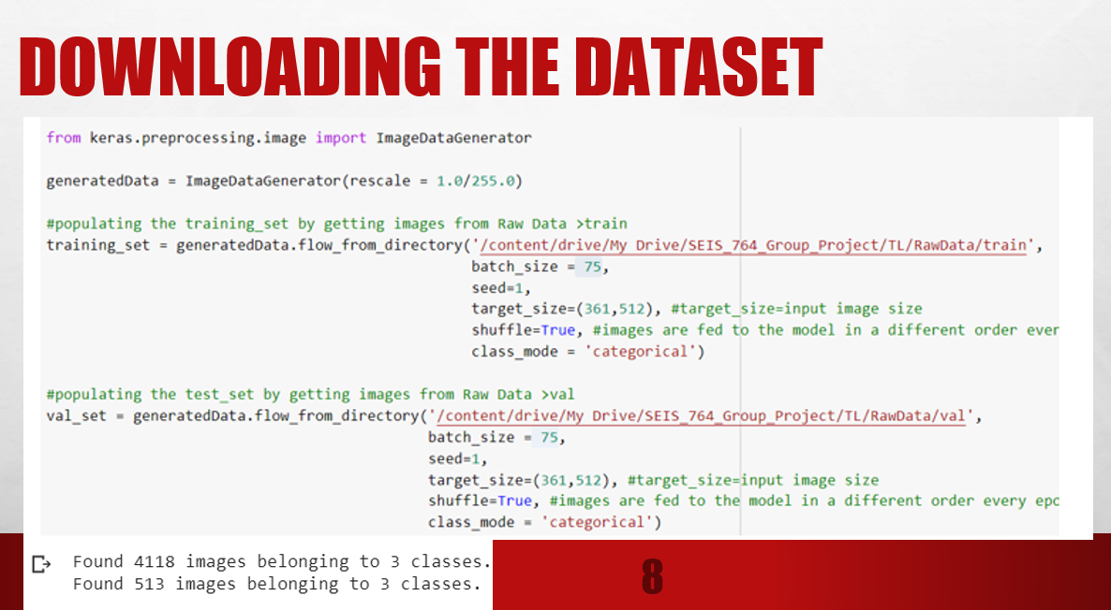

Slide 19
Two Models
Scratch CNN
VGG16
ResNet50

Slide 20
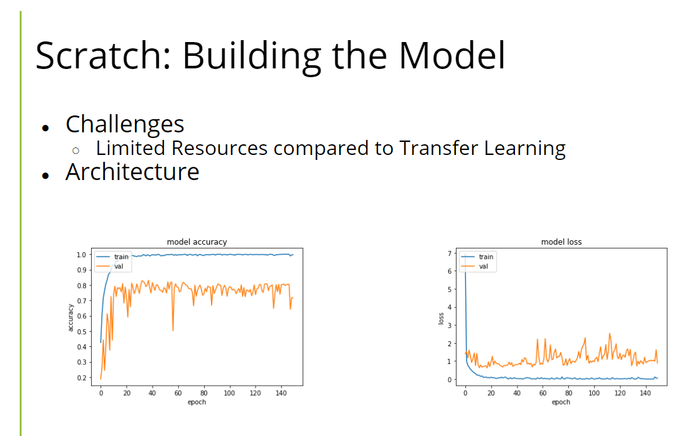

Slide 21
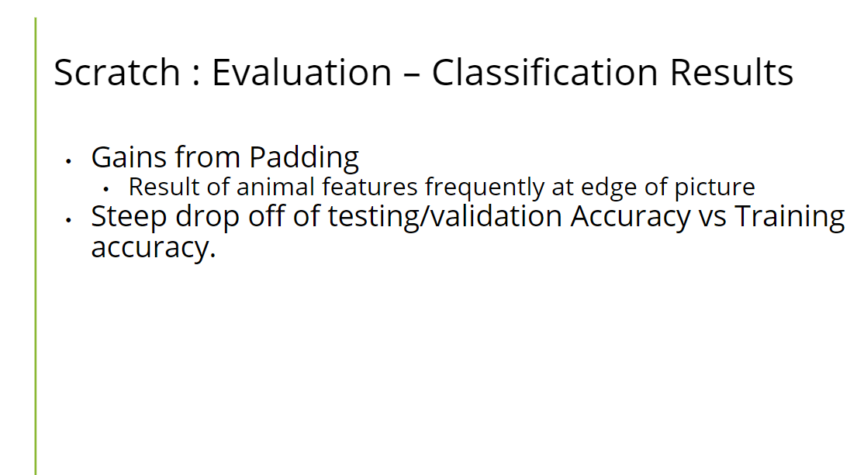

Slide 22
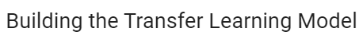
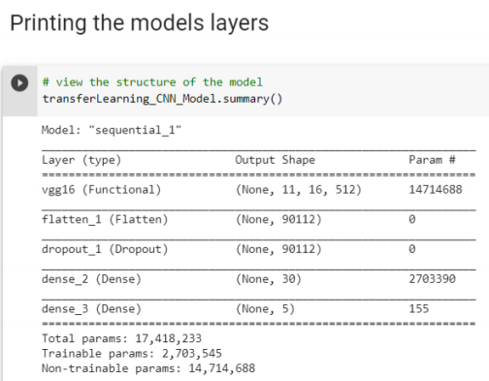
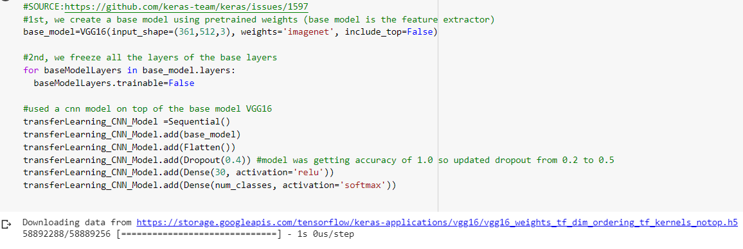
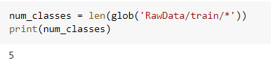
VGG16: Building the Model
input shape is a tensor (width, height, color channels)
base_model is all the layers minus the classification layer
Making the neural network 3 layers deep (more layers means increased changes of vanishing gradient descent problem)
freezing all the layers of the base model in order to use it as a fixed feature extractor
Using a bottleneck design for effective learning
Using dropout in order to have regularization to overfit the model

Slide 23
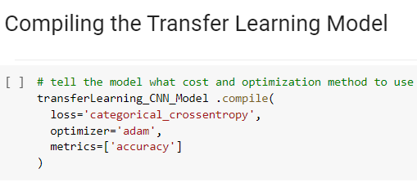
VGG16: Compilation
Training Time: 26.26 minutes
Training Accuracy: 0.9984
Using the loss function of categorical_cross entropy due to solving a multi classification problem
setting the metrics=accuracy in order to maximize the accuracy of the model
Using adam as the optimizer because its designed specifically for training deep neural networks Training and Testing curves mismatch per epoch is low indicating that the model is not under or overfitting

Slide 24
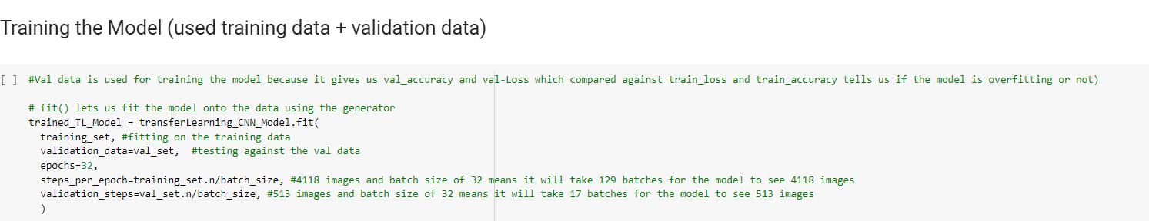
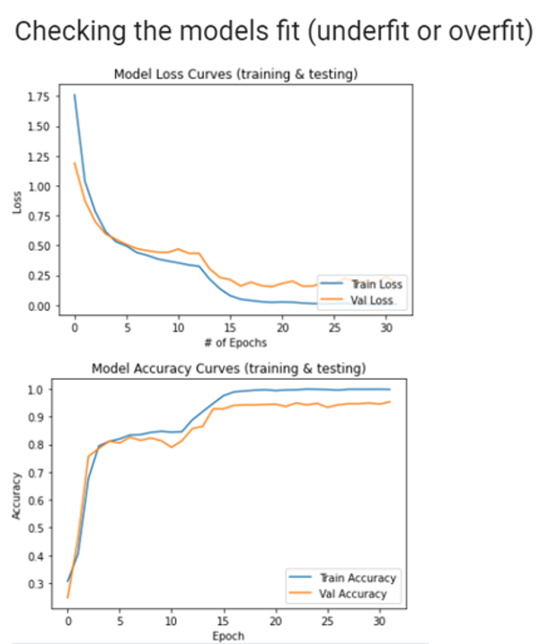
VGG16: Training
Training Time: 26.26 minutes
Training Accuracy: 0.9984 Validation Accuracy: 0.9537
Using the loss function of categorical_cross entropy due to solving a multi classification problem
setting the metrics=accuracy in order to maximize the accuracy of the model
Using adam as the optimizer because its designed specifically for training deep neural networks Training and Testing curves mismatch per epoch is low indicating that the model is not under or overfitting
Heuristic for Checking Model Fit: if (train_accuracy - val_accuracy) >5 then (model is overfitting)
else if (val_accuracy - train_accuracy) > 5 then (model is underfitting)
else absolute(train_accuracy-val_accuracy)<=5 then (model is a good fit)

Slide 25
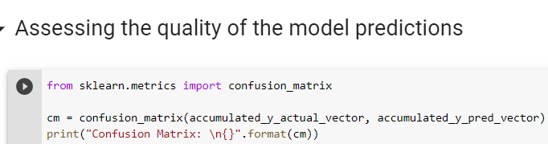
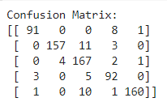
VGG16: Performance – Confusion Matrix
confusion matrix function takes vectors as arguments so the y_actual and y_pred were converted into a vector in order to plot the confusion_matrix

Slide 26
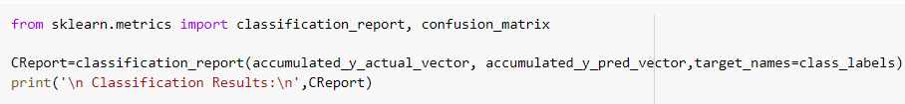
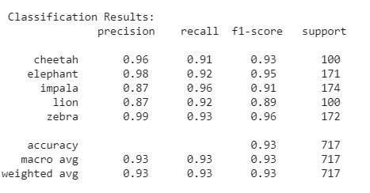
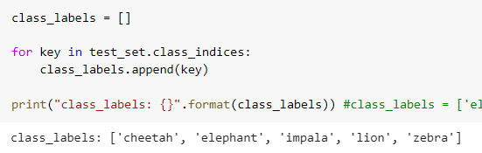
VGG16: Performance – Classification Results
Classification Report function takes vectors as arguments so the y_actual and y_pred were converted into a vector in order to plot the confusion_matrix. Furthermore, class_labels was stored as a vector as well in order to have class names next to the rows for precision, recall, f1 score and support in the Classification Report.

Slide 27
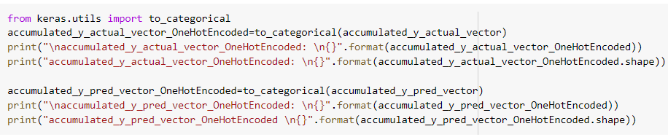
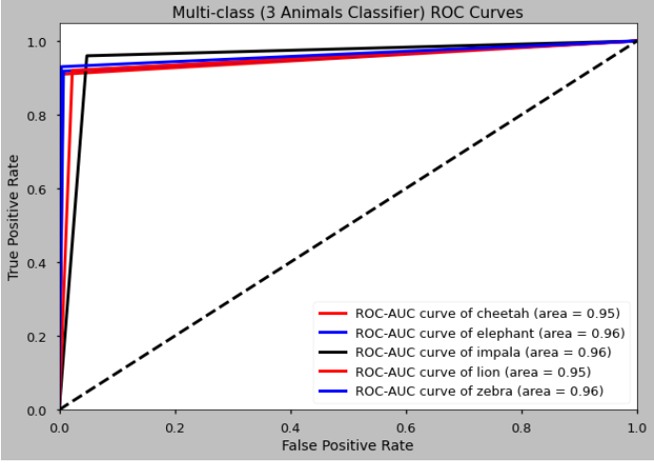
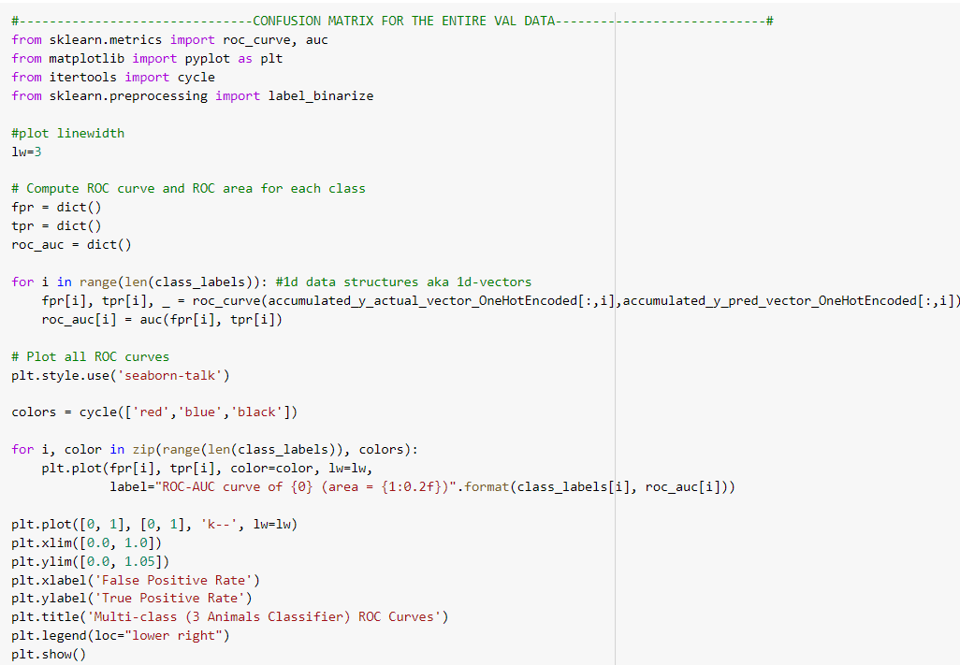
VGG16: Performance – ROC-AUC Graphs
y_actual and y_pred were converted from vectors into one hot encoded matrices in order to successfully plot the ROC-AUC graphs per each class label

Slide 28
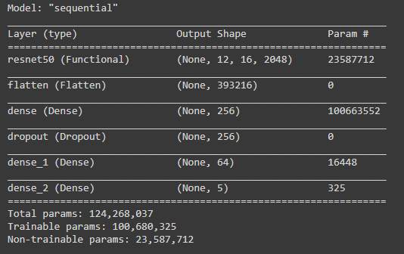
ResNet50: Building the Model

Slide 29
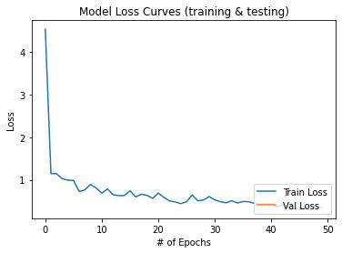
ResNet50 : Compilation and Training
TL_Model.compile(loss='categorical_crossentropy', optimizer="nadam", metrics=['categorical_accuracy'])
4819.376160144806

Slide 30
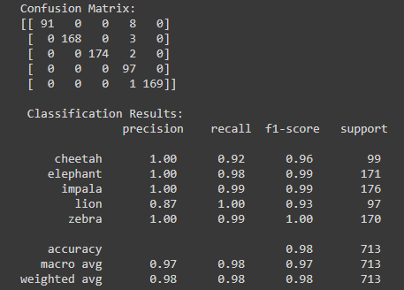
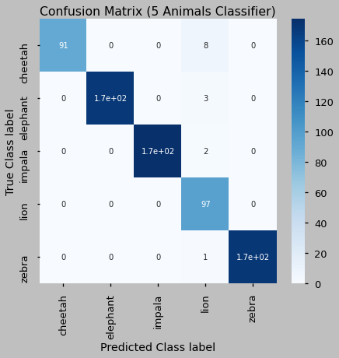
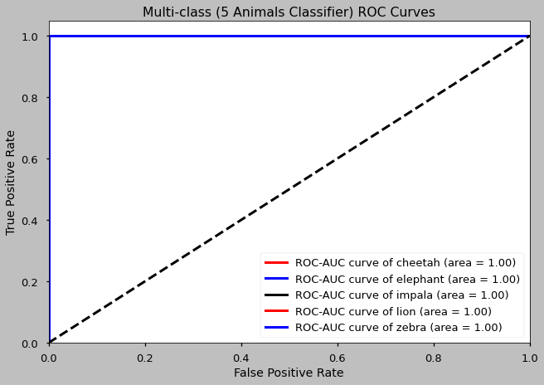
ResNet50 : Performance – Classification Results

Slide 31
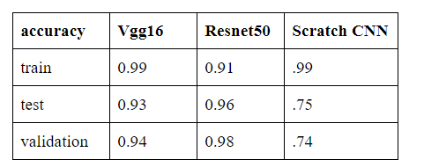
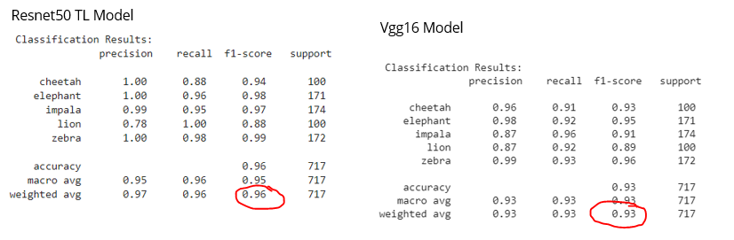
TL Model Comparison
Vgg 16 models abs(train_accuracy-val_accuracy)=abs(0.99-0.94)=0.05 which suggests an ideal model fit thus the Vgg16 model is a good generalizer for handling large testing datasets.
Resnet models abs(train_accuracy-val_accuracy)=abs(0.91-0.98)=0.07 which suggests slight underfitting thus the Resnet model is an okay generalizer for handling large testing datasets.
Vgg16’s unweighted average f1 score is 0.93 while Resnets 50’s unweighted f1 score is 0.95.
Notes:
Vgg16’s average f1 score is 0.93 while Resnets 50’s f1 score is 0.95
Vgg16 Model struggles in predicting impalas while Resnet50 struggles in predicting lions.

Slide 32
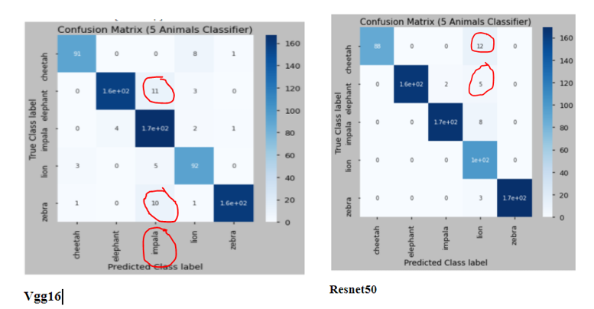
TL Model Comparison
Based on the confusion matrix, Vgg16 Model struggles in predicting impalas Based on the confusion matrix, Resnet50 struggles in predicting lions.
Notes:
Vgg16’s average f1 score is 0.93 while Resnets 50’s f1 score is 0.95
Vgg16 Model struggles in predicting impalas while Resnet50 struggles in predicting lions.

Slide 33
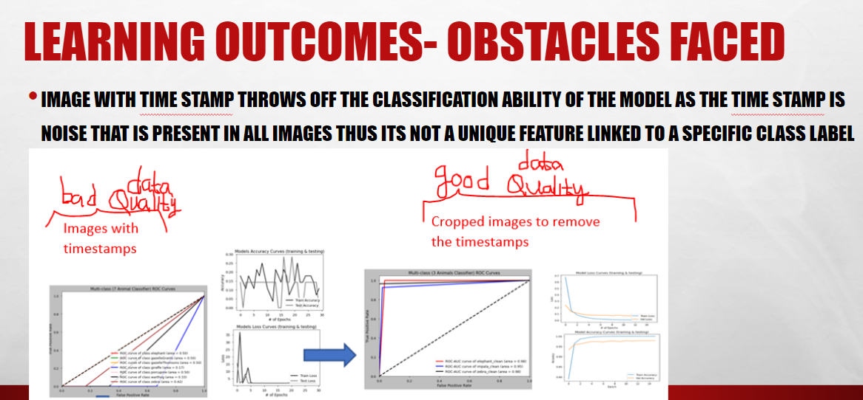

Slide 34
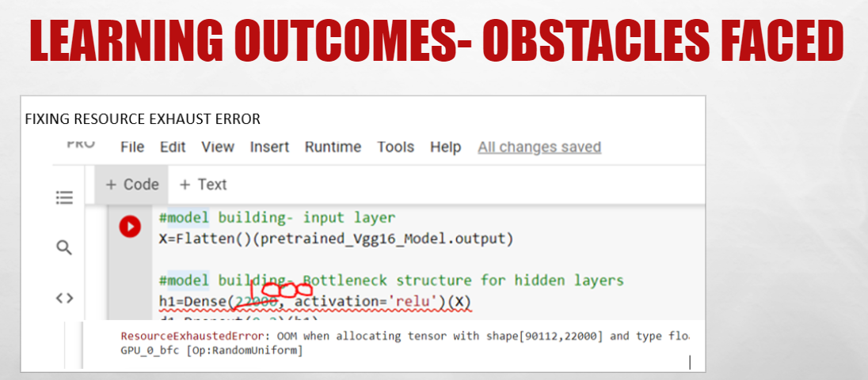

Slide 35
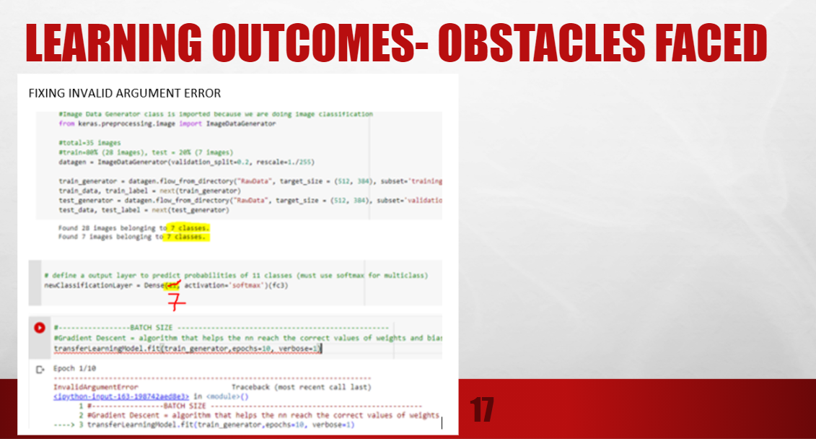

Slide 36
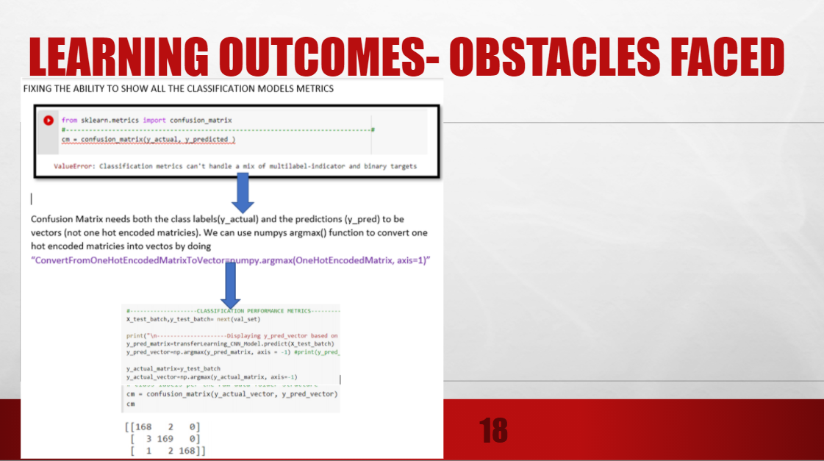

Slide 37
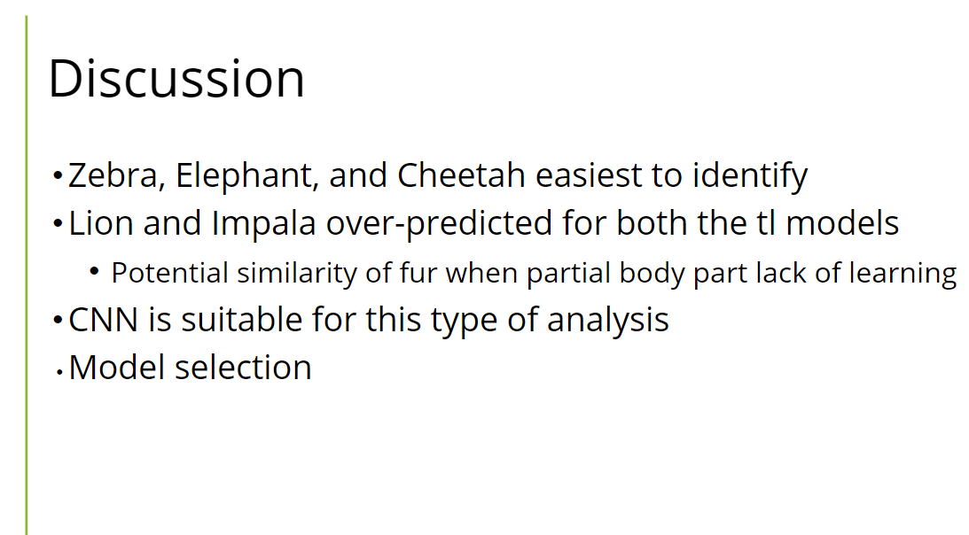

Slide 38
Future Improvements
Optimizing callbacks to minimize loss & maximize accuracy
Do NN visualizations to better understand the mind of the NN
Incorporate more species, experiment with sub-optimal images
Find a way to handle blank images

Slide 39
Questions
THE END

